Slide 1

Developing
for the
Commodore 64

Slide 2
Outline
About Me
Why Program for the C64
About the C64
Getting Started
Examples
Next Steps
Q&A

Slide 3
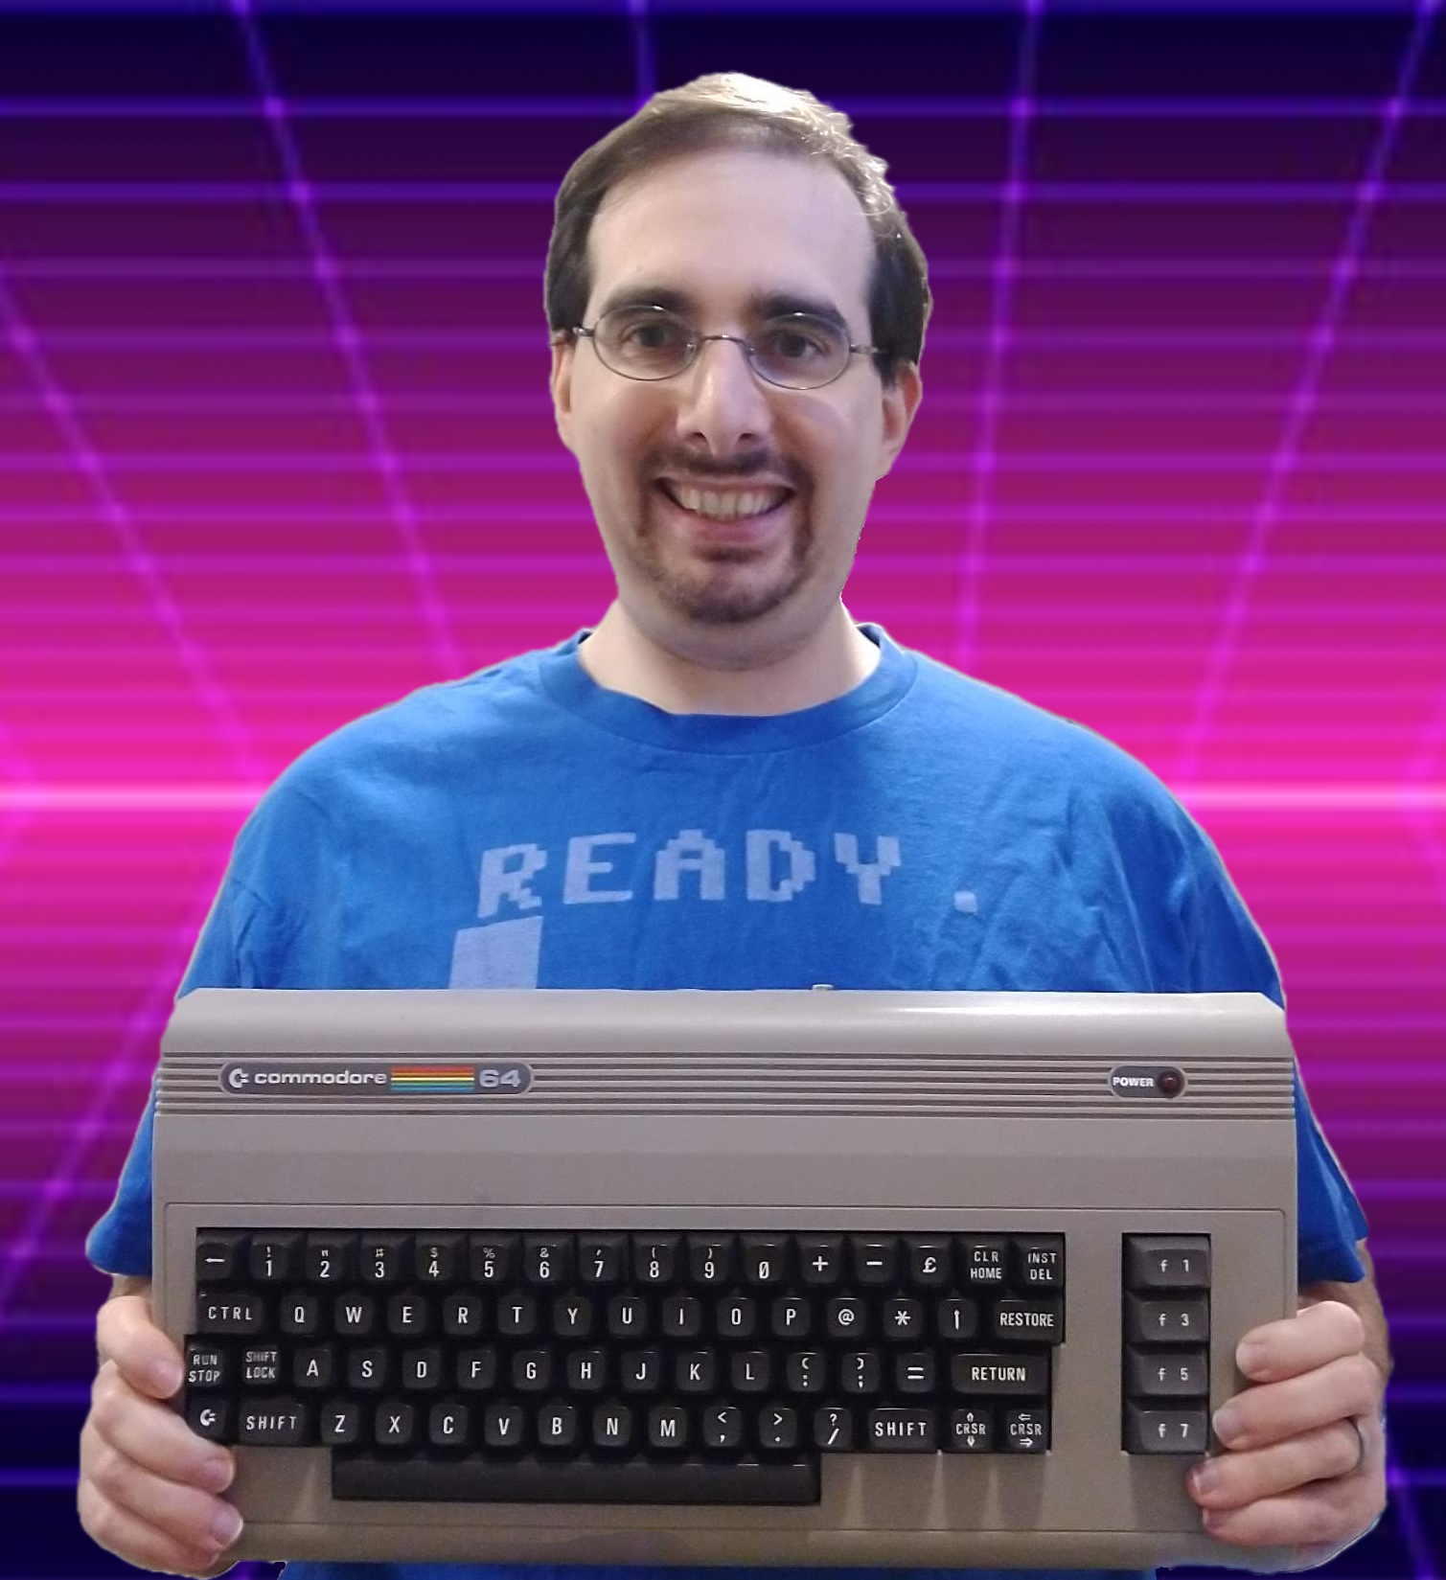
About Me (Michael Battaglia)
First started programming on the TI-99 in the mid 80s.
BASIC
Moved over to the C64 from the late 80s to early 90s.
BASIC V2
Then onto Windows 3.1 / DOS 6.22 from the mid 90s.
QBASIC, VB6, C++
Onto Windows 95/98 in the late 90s.
VB6
Onto Windows 2000/XP/VISTA/7 in the 2000s.
VB6, C++, Java, C# (Windows CE), PalmOS (AppForge)
Onto Windows 8/10 from the 2010s through today.
VB6, C#, ASP .NET, Android/iOS (Cordova), X86, 6502

Slide 4
Why Program for the C64
8-bit computing never really went away.
Emulators for 8-bit computers and consoles.
NES Classic, C64 Mini/Maxi
C64 is the highest-selling single computer of all time.
Between 12-17 million units sold.
Many new games and demos are still being created to this very day!

Slide 5
Planet X2

Slide 6
Super Mario Bros 64

Slide 7
Fix-it Felix Jr

Slide 8
About the C64
Released by Commodore in 1982.
6510 CPU – 8 bit at ~1 MHz with 64 KB of RAM (20 KB ROM).
Registers: A, X & Y, P, PC, SP.
VIC-II – 16 colors, 8 hardware sprites, used mapped memory.
40 columns x 25 rows (character mode)
320x200 pixels (HiRes mode)
Multicolor modes available but reduced the number of columns.
SID – 3 voices, ADSR envelope
Arguably the best sound chip from this area of computing.

Slide 9
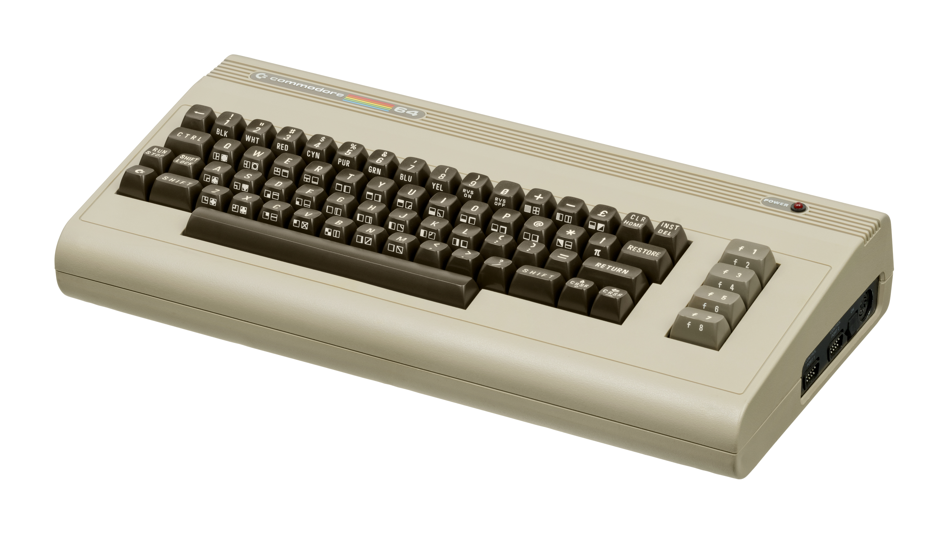
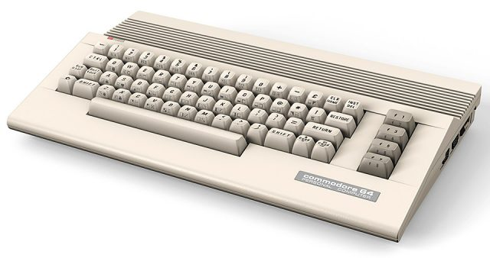
Breadbox (1982)
64C (1986)

Slide 10

About the C64
By default, the C64 reserved 26 KB of RAM
BASIC, KERNAL, ZP, STACK, I/O, Characters
Leaves 38 KB of RAM for the programmer
You can switch out the BASIC and KERNAL to get an additional 16 KB of RAM.

Slide 11
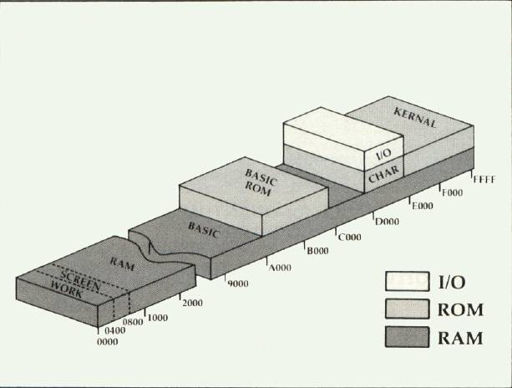

Slide 12
Getting Started
VICE https://vice-emu.sourceforge.io/
CBM prg Studio https://www.ajordison.co.uk/
6502 Assembly ML
Optional – Actual C64 with SD2IEC

Slide 13
Getting Started
Why Assembly language?
Pros:
Very fast
Highest level of control
Cons:
Harder to read and write
Portability issues

Slide 14
Getting Started
Number schemes:
Decimal (0-9)
Binary (0-1)
Hexadecimal (0-F)
8 bit (Byte) – 0 to 255
255 = Decimal
%11111111 = Binary
$FF = Hexadecimal
Base & Power | 2⁷ | 2⁶ | 2⁵ | 2⁴ | 2³ | 2² | 2¹ | 2⁰
Decimal Value | 128 | 64 | 32 | 16 | 8 | 4 | 2 | 1
Example | 1 | 1 | 1 | 1 | 1 | 1 | 1 | 1

Slide 15
Getting Started
16 bit (Word) – 0 to 65535
4 bit (Nibble) – Representing Hex ($FA)
16 bit, 2 byte number (Word)
High Byte (MSB) |  |  |  |  |  |  |  | Low Byte (LSB)
2¹⁵ | 2¹⁴ | 2¹³ | 2¹² | 2¹¹ | 2¹⁰ | 2⁹ | 2⁸ | 2⁷ | 2⁶ | 2⁵ | 2⁴ | 2³ | 2² | 2¹ | 2⁰
8 bit, 2 nibble number (Byte)
High Nibble |  |  |  | Low Nibble
2⁷ | 2⁶ | 2⁵ | 2⁴ | 2³ | 2² | 2¹ | 2⁰

Slide 16
Getting Started
Instructions – 56 opcodes
lda – Loads value into the Accumulator
sta – Stores value from the Accumulator
lda #2 ; decimal 2 (value) -> A sta $0400 ; A -> 400 hex (address)
lda $0400 ; 400 hex (address) -> A
sta $0401 ; A -> 401 hex (address)

Slide 17
Getting Started
Addressing
Zero Page – First 255 bytes of RAM
lda #2 ; immediate (2 cycles) lda $02 ; zero page (3 cycles)
lda $2000 ; absolute (4 cycles)

Slide 18
Getting Started
Indexing
myList byte $4F, $5A, $B2, $CE, $30, $25, $F9, $1D
ldx #2
lda myList,x ; 3rd item in list -> A (4 cycles*)
lda #<myList ; LSB
sta $FD
lda #>myList ; MSB
sta $FE
ldy #06
lda ($FD),y ; 7th item in list -> A (5 cycles*)

Slide 19
Getting Started
Adding Word to Memory
ldx #<$0401 stx $FD ldx #>$0401 stx $FE
Memory Address | Byte Value
$fd | $01
$fe | $04

Slide 20
Getting Started
Self-modifying Code
@label
sta $1000,y
ldx #<$0401 stx @label+1 ldx #>$0401 stx @label+2
OpCode | LSB | MSB
$99 | $00 | $10
$99 | $01 | $10
$99 | $01 | $04

Slide 21
Getting Started
Flow Control
jmp – Jumps to an absolute memory address.
jsr/rts – Jumps to a subroutine and returns.
Branches – Jumps to a memory address based on the values in the P register (example: beq)
Negative Flag | Overflow Flag | (Unused) | Break Command | Decimal Mode | Interrupt Disable | Zero Flag | Carry Flag

Slide 22
Examples
CBM prg Studio / Debugging
Indirect indexing vs. Self-modifying code
Writing string to the screen
Subroutines
Printing multiple strings

Slide 23
Next Steps
Input from Keyboard / Joysticks
Sprites / Custom Character Maps
Interrupts
Sound Effects / Music
Loading / Saving

Slide 24
Q & A
Commodore 64 Programming Reference Guide
Retro Game Dev https://www.retrogamedev.com/
C64 Memory Map http://sta.c64.org/cbm64mem.html
Codebase 64 https://codebase64.org/
Lemon64 Forums https://lemon64.com/forum
Michael Battaglia (aka VBGuyNY) https://battaglia.ddns.net/

